Slide 1
Insertion Sort
2023/02/18

Slide 2
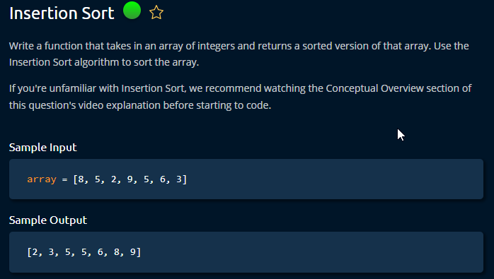

Slide 3
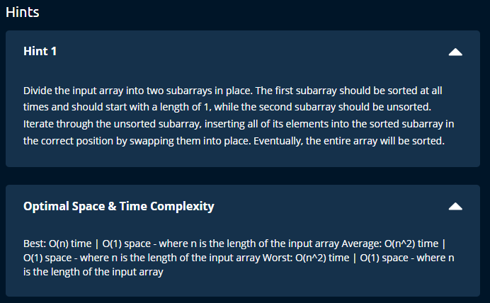

Slide 4

Insertion sort
Compare side by side and then swap.
Time = O (n){best} , O (n *2) {worst}
Space = O (1)
}

Slide 5
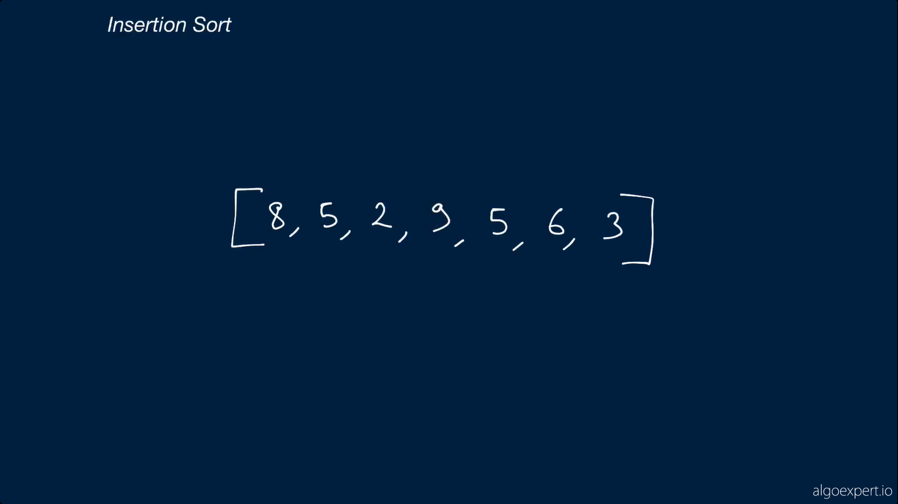

Slide 6
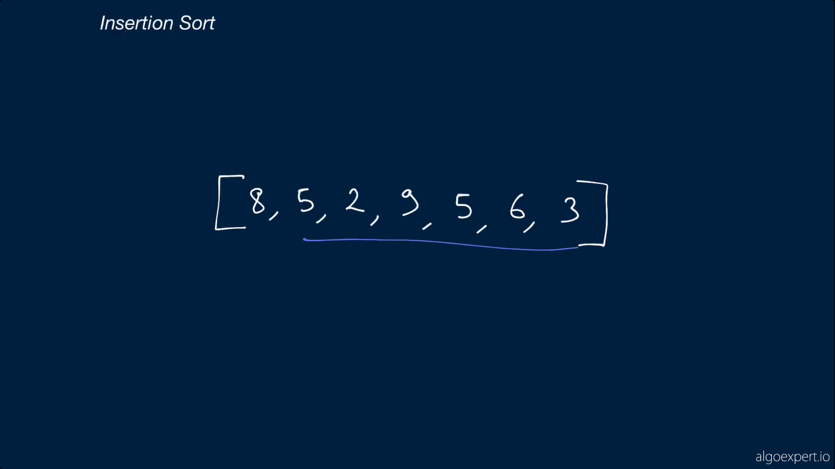

Slide 7
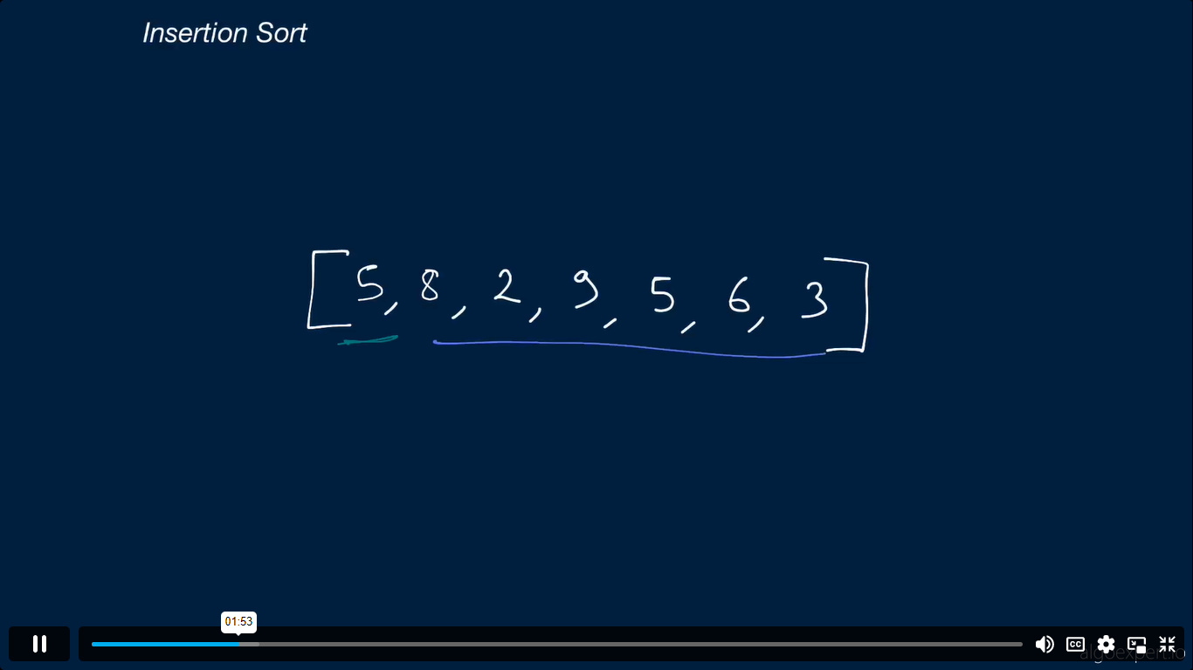

Slide 8
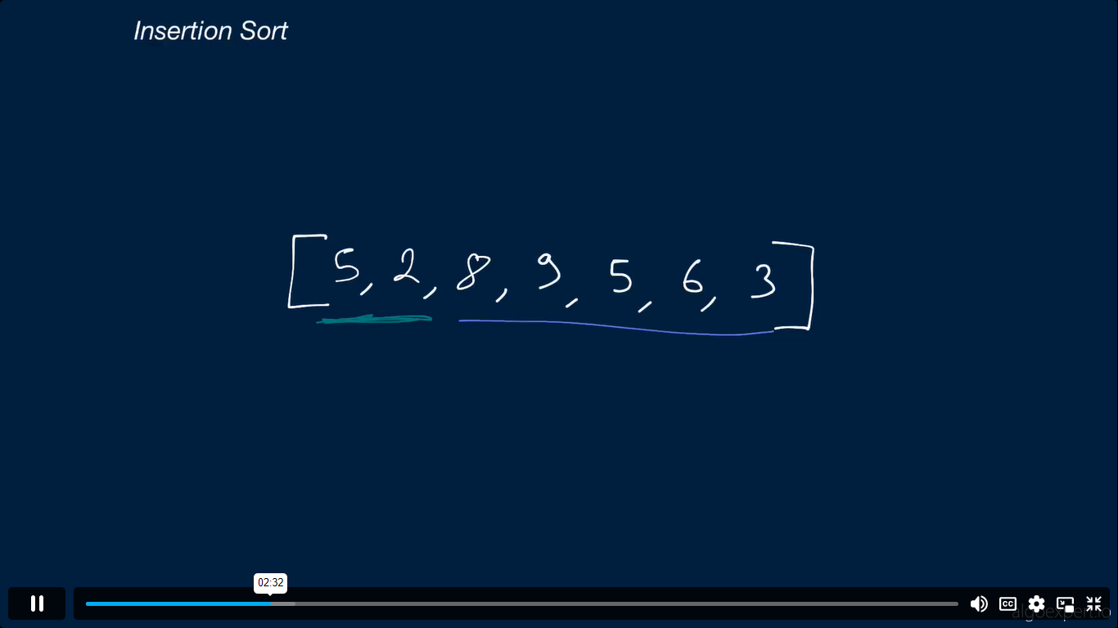

Slide 9
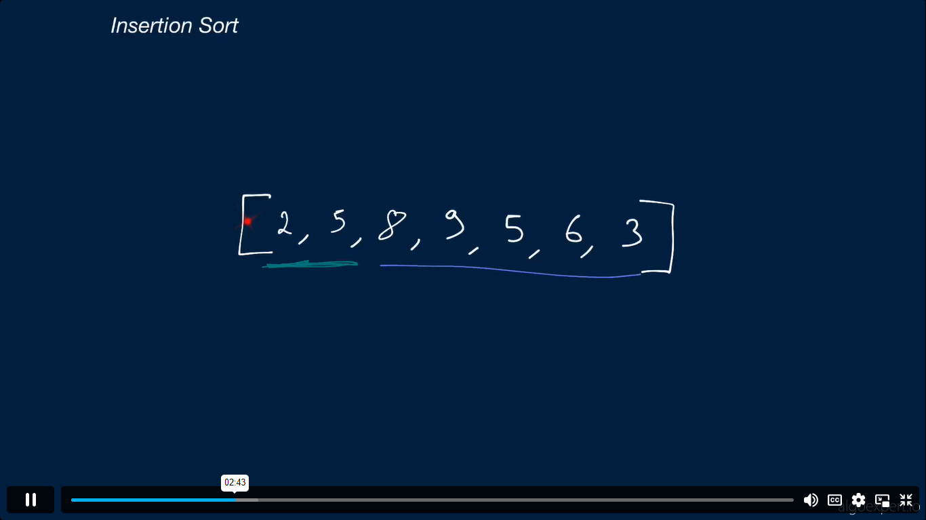

Slide 10
